Slide 1


Back - End Workshop
10 Nov 2013

Slide 2

Agenda
Structure Overview
Framework Detail
How to use Framework
Unit Test Framework

Slide 3
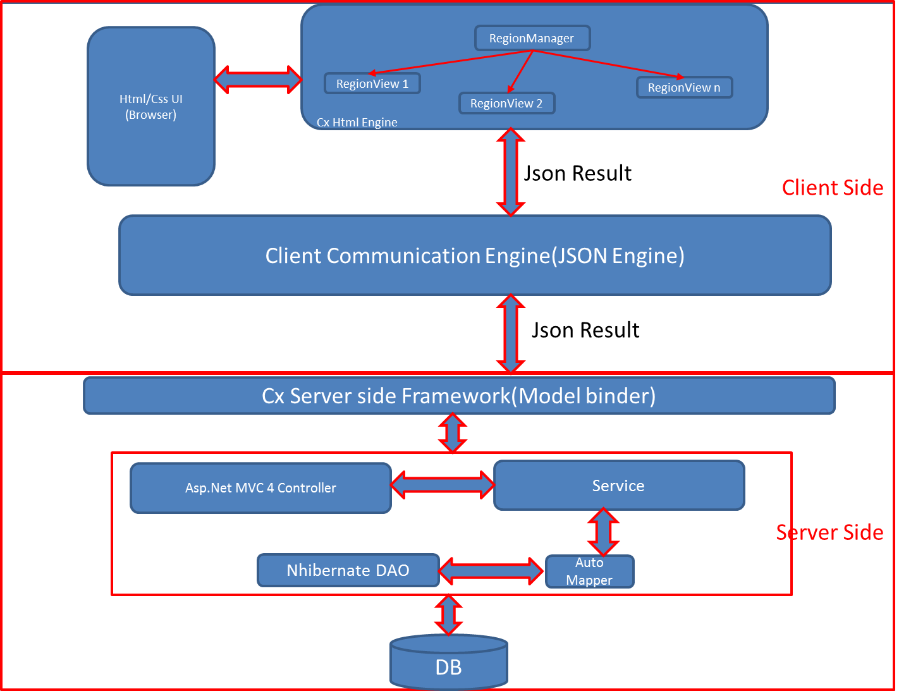
Structure Overview

Slide 4
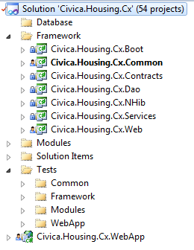
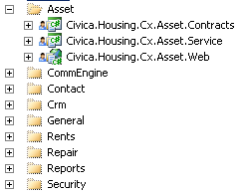

Overview
Store CxDatabase project. Devs must update this project if there is any changed database
All framework projects.
Note: Devs don’t modify if isn’t approve from TLs and TAs

Slide 5
Setup Environment
VS2010/VS2012: \\192.168.194.55\Civica_Setup\VS2012\en_visual_studio_ultimate_2012_x86_dvd_920947.iso
SqlLocalDB support for Unit test: \\192.168.194.55\Civica_Setup\SqlLocalDB
Source Code:

Slide 6
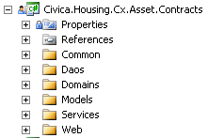
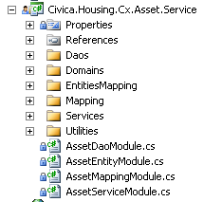
How to use framework
Example for Security module
Civica.Housing.Cx.XXX.Contracts
Contain all Contract classes which can be used by other Modules as
Common will have if we need to implement the common source code (features for the module)
Daos: contain Dao interfaces
Domains: contain entity interfaces
Models: contain all models which will return from Service layer
Services: contain Service interfaces
Web/ViewModels: store all view models that will be used in the web view, Ideally each view will use 1 view model
Civica.Housing.Cx.XXX.Service
Domains
Contain all Entity classes of this Module
Should has entity module class which inherit from EntityModuleBase class to allow Bootstrapper detect this assembly is Entity Module

Slide 7
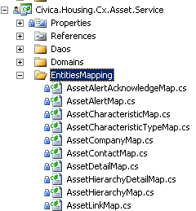

How to use framework (cont.)
Example for Security module
EntitiesMapping
Contain all Mapping classes and name queries files (hbm.xml)
Must has mapping module class which inherit from MappingModuleBase class to allow Bootstrapper detect this assembly is Mapping Module
If you would like to use SQL Function in Queryable statement, please use as below to add Static class which contain SQL Function

Slide 8

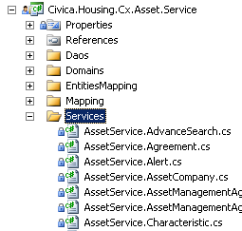
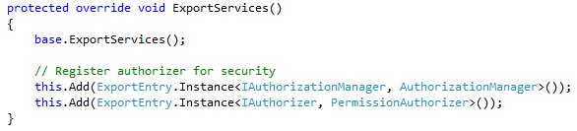
How to use framework (cont.)
Example for Security module
Daos
Contain all Dao implementation classes
Must has Dao module class which inherit from DaoModuleBase class to allow Bootstrapper detect this assembly is Dao Module
Services
Contain all Service implementation classes
Must has Service module class which inherit from ServiceModuleBase class to allow Bootstrapper detect this assembly is Service Module
If you would like to register implementation some interface from other Modules, please use as

Slide 9
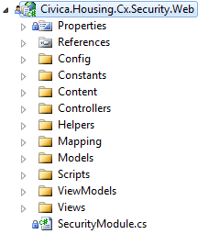
How to use framework (cont.)
Example for Security module
Services (cont.)
Any method in Service layer with prefix "Exec", "Add", "Update", "Delete", "Set", "Insert", "Save“ will process in transaction scope
Civica.Housing.Cx.XXX.Web: same layout of ASP.MVC

Slide 10
How to use framework (cont.)
Web Project
Views: keep all View in structure as MVC convention all view must be set as embedded resource. So when build system will automatically keep them in dll files will extract when application Load.
Controllers: as MVC convention Controller
Web
Controllers
Scripts
Feature.Manager.js
Feature.ProcessTitle.js
FeatureController.cs
Views

Slide 11
How to use framework (cont.)
Web Project
Scripts: all javascripts of the module have to be kept here and set as Embedded resources
Script Convention as picture above and contain
1 civica.modeuleName.XXX.Manager.js(civica.RentElement.Manager.js) process all initial Script in theory this will create a lozenge with subviews
Civica.modeuleName.XXX.ProcessTile (civica.rentElement.ProcessTile.js) add all processtiles and Inittial Script for ProcessTile
Civica.modeuleName.xxx.js: process for corresponding subView.

Slide 12
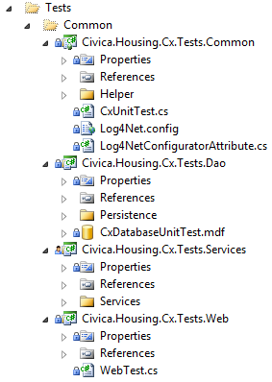
Unit Test Framework
The Unit Test framework is developed for:
Support run LocalDB on TFS
Reduce duplicated code between Unit Test projects
Create common base class for Unit Test on
Data Access layer
Service layer
Web layer
To avoid conflict data in DB during running Unit Test, we apply solution:
Begin transaction before run Unit Test
Then rollback transaction after finish 1 Unit Test

Slide 13
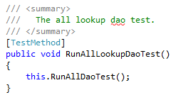
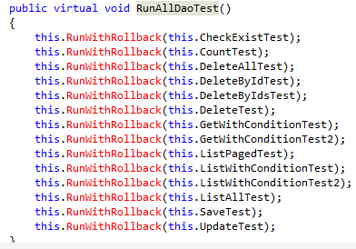
Unit Test Framework - Example
Example: Data Access layer
Generic DAO: IDao<Lookup, int>
Create LookupDaoTest inherit from GeneralDaoBase and implement abstract methods as:
Compare: compare 2 Lookup classes
CreateEntity: create new Lookup class
Update: update 1 or many properties in Lookup class
Query: query Lookup class
In abstract GeneralDaoBase class must have 2 methods:
DaoBaseSetup:
With TestInitialize attribute
Add appropriate Mapping, Entity or Service Module
Call SetUp and BeginTransaction method
DaoBaseCleanup
With TestInitialize attribute
Call RollbackTransaction method

Slide 14
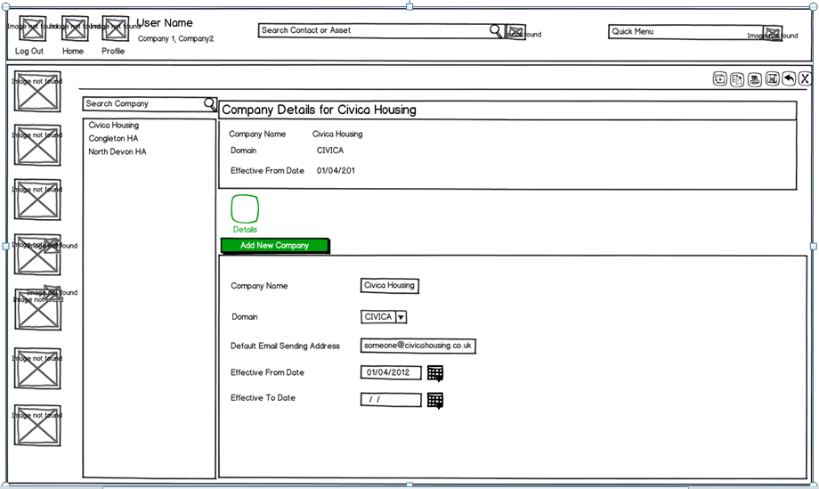
Example – Company management
Refer Civica_Repairs_MS4_UC-CON-15_Manage Company.doc file

Slide 15
Example – Company management
Define all related Tables
Check Tables existed or not
Create Entity interfaces and classes at correct module, namespace and class name
Create Mapping for above Entities. Note: if there is any relationship mapping as 1-1, 1-n, n-n…, please follow below formula
ID: map normally
Object: use ReadOnly to avoid break mapping
Please see example in LookupMap:
this.Map(x => x.LookupTypeId).Nullable();
this.References<LookupType>(x =>
x.LookupType).Column("LookupTypeID").ReadOnly();

Slide 16
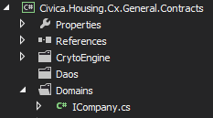
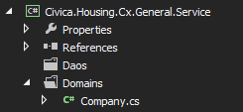
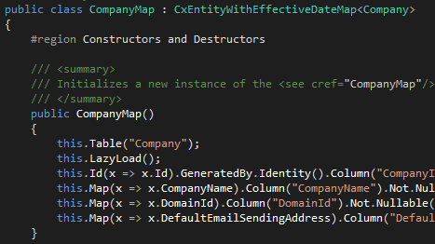
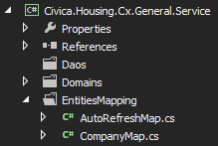
Example – Company management

Slide 17
Example – Company management
Create Model class and place in Civica.Housing.Cx.XXX.Contracts.Models
Create Service interface. Note:
Any method in Service layer with prefix "Exec", "Add", "Update", "Delete", "Set", "Insert", "Save“ will process in transaction scope
Parameter and return type of Service method is Model class, don’t allow to use Entity class
Usually each Use Case will have 1 Service interface
Implement Service interface. Note:
Naming convention of file name
Create Dao variable in constructor of Service class

Slide 18
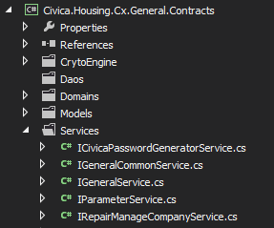
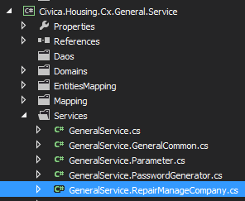
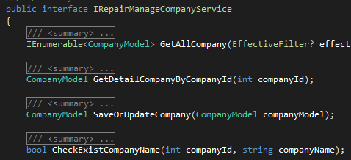
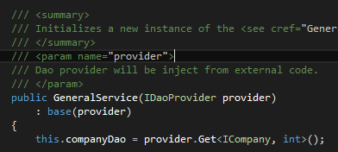
Example – Company management

Slide 19
Example – Company management – Unit Test
Create Unit Test for Dao company, please follow slide#13

Slide 20
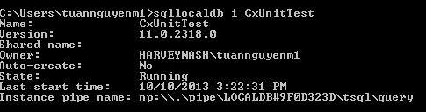
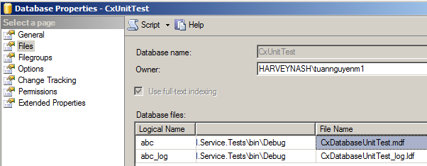
Example – Company management – Unit Test
Command to access sqllocaldb
sqllocaldb i CxUnitTest
Copy “Instance pipe name” to connect to DB
Do any actions to DB: insert, update, delete… and then copy path of file from property of DB
Disconnect and copy DB file and overwrite to Civica.Housing.Cx.Tests.LocalDb\CxDatabaseUnitTest.mdf and CxDatabaseUnitTest_log.ldf

Slide 21
Run project
Add application in IIS:
Physical path: link to …\WebApp folder
Application pool: ASP.NET v4.0
Login
Username: civica
Password: converge
Database
Server=192.168.194.55;
Database=CxTraining;
User Id=civicatraining;
Password=civica@123;

Slide 22
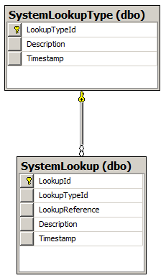
Exercise
Create interface, class, mapping and write DAO unit test for 2 below tables:

Slide 23
Exercise
Create Service interface for System Type Use case. The service will contain below methods:
Get all SystemLookupModel which have:
Select: all column of SystemLookup and SystemLookupType tables
Condition: SystemLookupType.Description like ‘HVN’ and SystemLookup.Description like ‘HVN’
Order by LookupTypeId (desc = false) and Description (desc = true)
Get all SystemLookupTypeModel which have:
Select: all column of SystemLookup and SystemLookupType tables
Condition: SystemLookupType.Description like ‘HVN’ and SystemLookup.Description like ‘HVN’
Order by LookupTypeId (desc = false) and Description (desc = true)
Fetch SystemLookup
Save and Update SystemLookupModel and SystemLookupTypeModel
Write Unit Test for exercise#2

Slide 24
Q&A
Notes:
24

